Slide 1
Sania Khalid
MSDSF23M016

Slide 2
INTELLIGENCE
TRANSPORTATION SYSTEMS

Slide 3
ITS
With the progress of urbanization and the popularity of automobiles, transportation problems are becoming more and more challenging: traffic flow is congested, accidents are frequent, and the traffic environment is deteriorating. One efficient way to improve the traffic environment is to establish an efficient and accurate transportation system, which can help us better arrange transportation resources, disperse the traffic flow before it is overloaded, and even provide more abundant on-road entertainment.

Slide 4
OBJECTIVES: ITS
Utilizing machine learning models, including CNN, LSTM, and other models to predict traffic patterns and congestion. By analyzing historical data and real-time information, the system can forecast traffic conditions. By taking advantage of the development of the 5G communication system, abundant on-road sensors, etc., ITS can improve traffic efficiency, ease traffic congestion, increase road capacity, and reduce traffic accidents and environmental pollution.

Slide 5
DATASET: ITS
Following features are there in dataset:
DataTime
Vehicles
Junctions
Vehicle ID

Slide 6
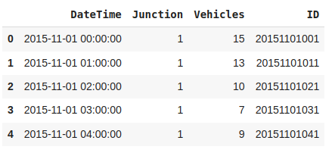

Slide 7
Models Used
MLP: Multi-Layer Perceptron
CNN: Convolutional Neural Network
LSTM: Long Short-Term Memory
GRU: Gated Recurrent Unit

Slide 8
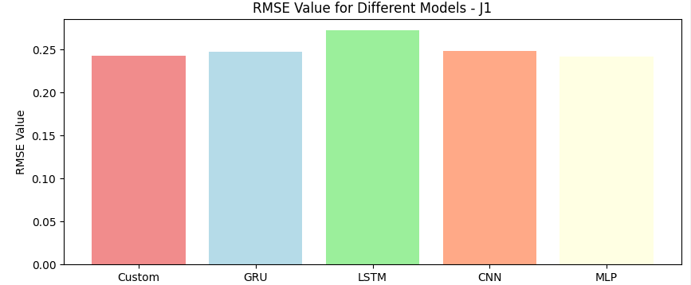
RMSE: J1

Slide 9
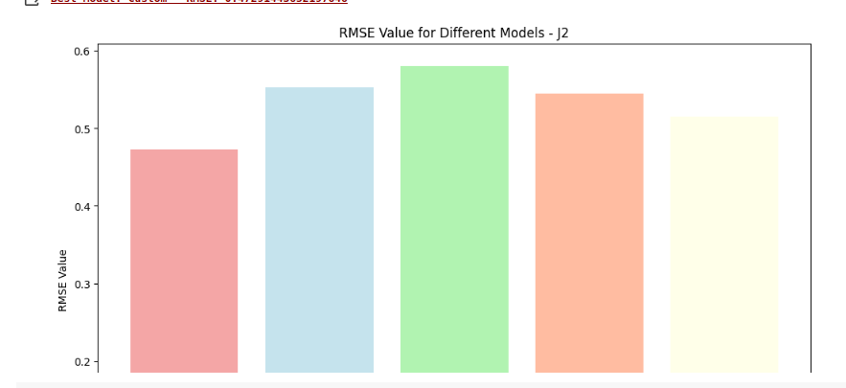
RMSE: J2

Slide 10
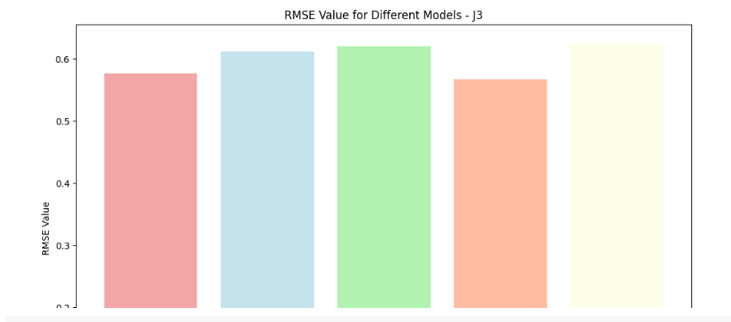
RMSE: J3

Slide 11
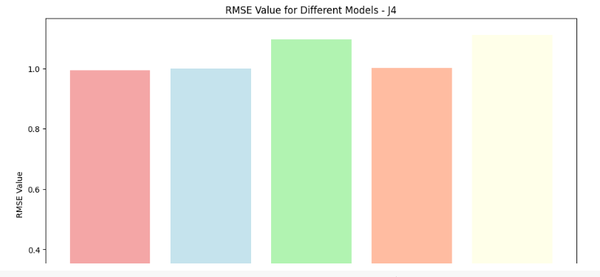
RMSE: J4

Slide 12
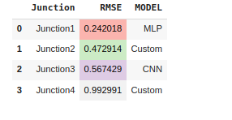
RMSE Comparison

